Slide 1



Drip Ease - Seamless IV Placement
Presented by : CyberPunks
Vishal.B
G.S.Ruparani
Sudhiksha.K
Pushkala.S
Shiv Nadar University, Chennai

Slide 2

Motivation :
Manual IV drip placement in healthcare presents challenges like inaccuracies and patient discomfort, leading to complications and inefficiencies. To overcome these issues, advanced technology like machine learning, 3D modeling, and augmented reality can enhance accuracy and provide effective training tools.
Our solution, DRIPEASE, revolutionizes IV drip placement, improving patient outcomes and clinical efficiency. Implementation promises reduced complications, enhanced workflow, and cost savings, aligning with the trend of technology-driven healthcare solutions.

Slide 3
D
R
I
P
E
A
S
E
Problem Statement :
In healthcare, precise IV drip placement is crucial for patient well-being but existing manual techniques often results in accuracy challenges, leading to patient discomfort, which triggers the pressing need for a cutting-edge technology, to pinpoint optimal IV drip injection sites.
This innovation aims to elevate the quality of patient care & enhance the efficiency of medical practices.

Slide 4


Objectives :
Enhance precision and accuracy in IV drip placement.
Minimize patient discomfort and complications.
Provide real-time guidance for healthcare practitioners.
Improve training effectiveness through VR simulation.
Develop a user-friendly interface for seamless integration.
Ensure interoperability with existing healthcare systems.
Elevate the quality of patient care and clinical workflows.

Slide 5

Proposed System Design / Use Cases :
SIMULATION ( TRAINING ):
Venipuncture Training: Healthcare professionals can use the solution for hands-on training in
inserting IV needles and locating veins accurately in a realistic virtual environment through
Simulation.
SCALING DOWN MEDICAL COMPLICATIONS :
For children and patients with difficult-to-access veins due to obesity, dehydration, or previous
IV complications, the solution aids in locating suitable sites for IV placement.
VR HARDWARE SALES AND DISTRIBUTION :
Developing and selling VR hardware/software applications specifically designed for medical
training, including IV placement and vein location simulations.
Medical Device Integration :
Integrating the IV drip placement solution with existing medical devices, such as IV pumps and
patient monitors, offers a complete IV management system.

Slide 6
Solution/ Methodology :
DRIPEASE : Creating an advanced IV drip placement solution that combines machine learning, 3D modeling, and VR to elevate precision & accuracy, minimize complications & enhance training in healthcare environments.
ML & IMAGE ANALYSIS: To analyze medical images to identify veins and critical injection sites, ensuring precision using HOG function and UNET.
AR for REAL - TIME GUIDANCE: Integrated AR offers real-time visualization of veins in the hand, providing precise guidance for needle placement & reducing attempts.
VR TRAINING & SIMULATION: Healthcare practitioners benefit from immersive VR training scenarios for skill enhancement in vein identification & IV drip placement.
USER - FRIENDLY INTERFACE : An intuitive interface for healthcare professionals, simplifying vein map viewing & automated assistance during procedures.
INTERPERABILITY & INTEGRATION : Seamless integration with existing healthcare systems & electronic health records (EHR) ensures efficient workflow integration in clinical settings.

Slide 7
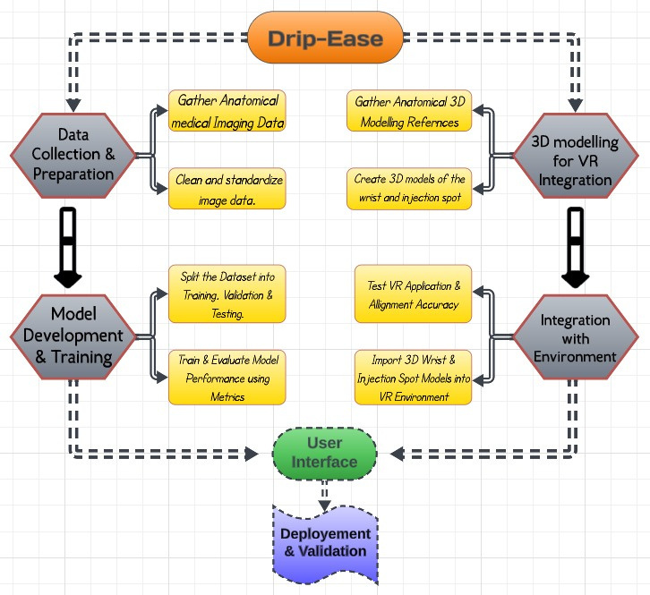
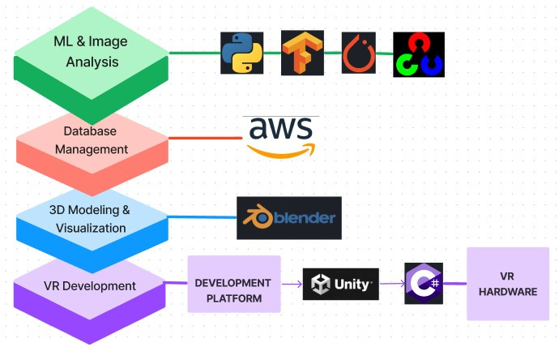
Technology Stack :
Process Flowchart :
Technology Stack :
Rufus Stewart

Slide 8


Dependencies / Challenges :
Data Availability
Anatomical Accuracy
Regulatory Compliance
Hardware Procurement
Testing Environment
Hardware Failures & Technical Glitches
08

Slide 9
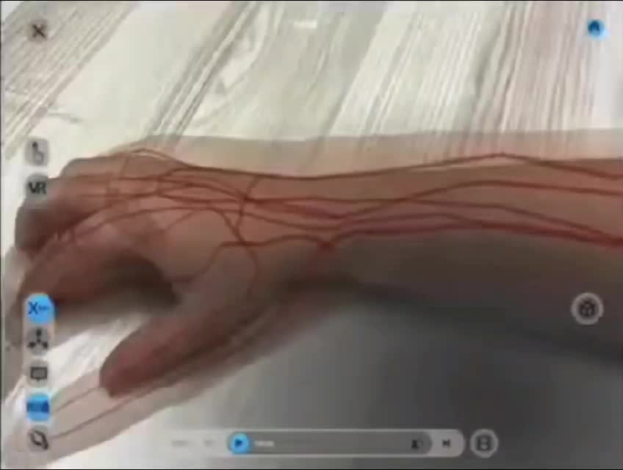
Explaination Video of the Project :
https://youtu.be/0BVESdFsSX0
Expected Prototype :

Slide 10
Thank
You.
By Cyberpunks

